Slide 1
Sequential Circuits
Part 2

Slide 2
Flip-Flops
The latch timing problem
Master-slave flip-flop
Edge-triggered flip-flop
Flip-flop timing

Slide 3
JK FLIP FLOPS

Slide 4
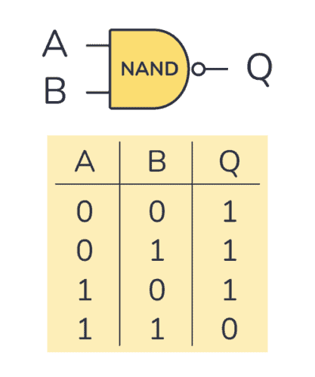
JK Flip Flop
Recall SR NAND Gate
A ‘0’ input to a NAND gate will always result in ‘1’ in the output

Slide 5
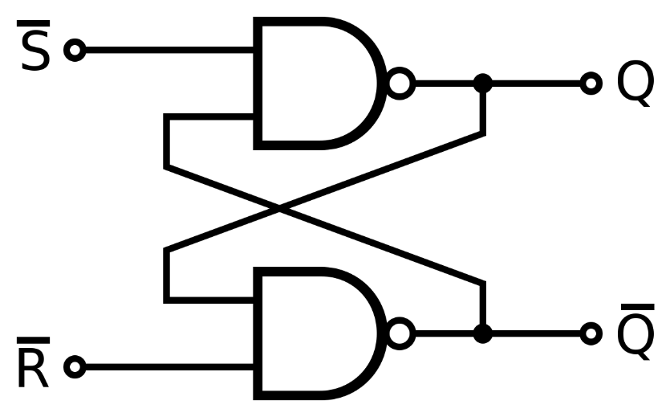
JK Flip Flop
Recall S’R’ NAND Latch
S’ | R’ | Qn | Qn’
0 | 0 | Undefined
0 | 1 | 1 | 0
1 | 0 | 0 | 1
1 | 1 | Memory

Slide 6
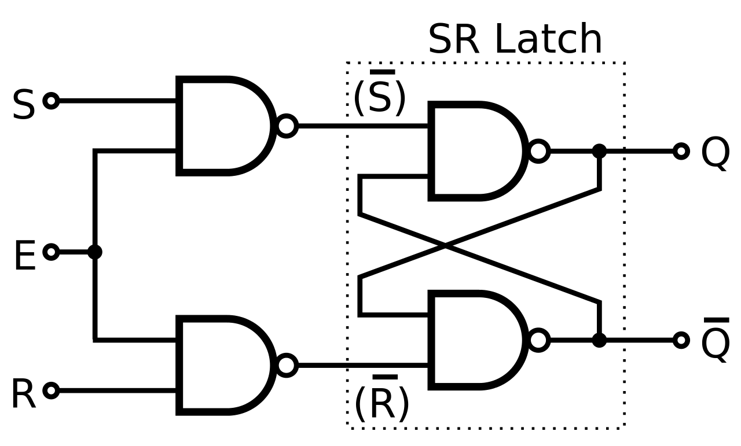
JK Flip Flop
Recall SR Flip Flop
SR NAND Latch
S’ | R’ | Qn | Qn’
0 | 0 | Undefined
0 | 1 | 1 | 0
1 | 0 | 0 | 1
1 | 1 | Memory
C
SR Flip Flop
Clk | S’ | R’ | Qn | Qn’
0 | X | X | Memory
1 | 0 | 0 | Memory
1 | 0 | 1 | 1 | 0
1 | 1 | 0 | 0 | 1
1 | 1 | 1 | Undefined

Slide 7
J-K Flip-flop
Behavior
Same as S-R flip-flop with J analogous to S and K analogous to R
Except that J = K = 1 is allowed, and
For J = K = 1, the flip-flop changes to the opposite state
As a master-slave, has same behavior as S-R flip-flop
If the master changes to the wrong state, that state will be passed to the slave
E.g., if master falsely set by J = 1, K = 1 cannot reset it during the current clock cycle

Slide 8
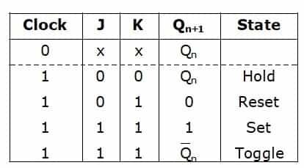

JK Flip Flop
JK Flip Flop
J
Memory
Memory
C
K

Slide 9
JK Flip Flop
JK Flip Flop
Memory
Memory
J
1
0
C
0 in a NAND results in 1.
No need to consider Q or Q’
1
S’ | R’ | Qn | Qn’
0 | 0 | Undefined
0 | 1 | 1 | 0
1 | 0 | 0 | 1
1 | 1 | Memory
K

Slide 10
JK Flip Flop
JK Flip Flop
Memory
Memory
J
1
0
1
C
0 in a NAND results in 1.
No need to consider Q or Q’
1
S’ | R’ | Qn | Qn’
0 | 0 | Undefined
0 | 1 | 1 | 0
1 | 0 | 0 | 1
1 | 1 | Memory
0
K

Slide 11
JK Flip Flop
JK Flip Flop
Memory
Memory
J
0
1
0
C
1
Case 1: Initially Q=0 and Q’=1
1
Then J=0 and K=1 results in
Q=0 and Q’=1
(i.e no change)
1
K
1
0

Slide 12
JK Flip Flop
JK Flip Flop
Memory
Memory
J
0
1
1
0
C
1
Case 2: Initially Q=1 and Q’=0
0
1
Then J=0 and K=1 results in
Q=0 and Q’=1
(i.e no change)
0
K
1
1

Slide 13
JK Flip Flop
JK Flip Flop
Memory
Memory
J
C
K

Slide 14
JK Flip Flop
JK Flip Flop
Memory
1
Memory
1
J
0
0
1
1
C
Case 1: There is Q=0 and Q=1 in the ckt
1
0
Case 2: There is Q=1 and Q=0in the ckt
1
1
K
0

Slide 15
JK Flip Flop
JK Flip Flop
Memory
0
Memory
J
1
1
0
1
0
1
C
Case 1: There is Q=0 and Q=1 in the ckt
1
0
1
Case 2: There is Q=1 and Q=0in the ckt
0
1
K
1

Slide 16
JK Flip Flop
JK Flip Flop
Memory
Memory
J
C
Hence Toggle inverts the value of Q and Q’
But problem: Continuously changing if both J and K =1
Q= 0,1,0,1,0,1,…
Q’= 1,0,1,0,1,0,…
K
The circuit is not in a stable state
This is known as racing

Slide 17
JK Flip Flop
Characteristic Table
How the state changes based on input
Q_{n} | J | K | Q_{n+1}
0 | 0 | 0 | 0
0 | 0 | 1 | 0
0 | 1 | 0 | 1
0 | 1 | 1 | 1
1 | 0 | 0 | 1
1 | 0 | 1 | 0
1 | 1 | 0 | 1
1 | 1 | 1 | 0
Excitation Table
Possible inputs for a particular state change
Truth Table
Clk | J | K | Q_{n+1}
0 | X | X | Q_{n}
1 | 0 | 0 | Q_{n}
1 | 0 | 1 | 0
1 | 1 | 0 | 1
1 | 1 | 1 | Q_{n}’
Q_{n} | Q_{n+1} | J | K
0 | 0 | 0 | X
0 | 1 | 1 | X
1 | 0 | X | 1
1 | 1 | X | 0

Slide 18
JK Flip Flop
Characteristic Table
How the state changes based on input
Q_{n} | J | K | Q_{n+1}
0 | 0 | 0 | 0
0 | 0 | 1 | 0
0 | 1 | 0 | 1
0 | 1 | 1 | 1
1 | 0 | 0 | 1
1 | 0 | 1 | 0
1 | 1 | 0 | 1
1 | 1 | 1 | 0
Excitation Table
Possible inputs for a particular state change
Truth Table
Clk | J | K | Q_{n+1}
0 | X | X | Q_{n}
1 | 0 | 0 | Q_{n}
1 | 0 | 1 | 0
1 | 1 | 0 | 1
1 | 1 | 1 | Q_{n}’
Q_{n} | Q_{n+1} | J | K
0 | 0 | 0 | X
0 | 1 | 1 | X
1 | 0 | X | 1
1 | 1 | X | 0
Find out the equation

Slide 19
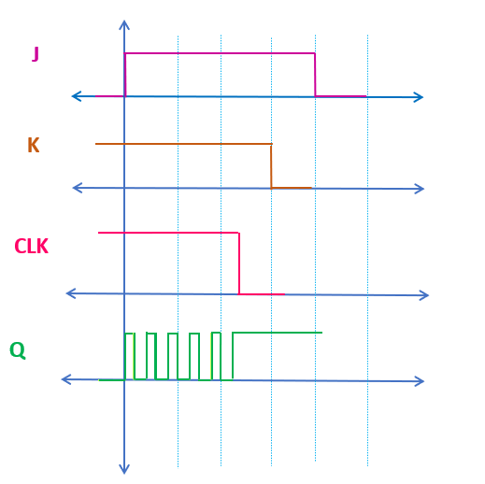
JK Flip Flop
We need to deal with the racing problem (race around condition)
We want to toggle only once.
The feedback connection is responsible for the racing condition
0
J
1
0
1
0
1
C
C
1
1
0
1
0
K
1
1

Slide 20
JK Flip Flop
The Racing Problem
Three Possible Solutions:
The control signal can be high for a very short time
Edge Trigger
Master Slave

Slide 21
JK Flip Flop
The Racing Problem
Three Possible Solutions:
The control signal can be high for a very short time
Edge Trigger
Master Slave

Slide 22
JK Flip Flop
The Racing Problem
Three Possible Solutions:
The control signal can be high for a very short time
Edge Trigger
Master Slave
No time given by control signal to start racing, the later outputs will be determined based on J and K
C
C
Q_{n+1}

Slide 23
JK Flip Flop
The Racing Problem
Three Possible Solutions:
T/2 < gate delay
Edge Trigger
Master Slave
C
Q_{n+1}

Slide 24
JK Flip Flop
The Racing Problem
Three Possible Solutions:
T/2 < gate delay
Edge Trigger
Master Slave

Slide 25
JK Flip Flop
Recall that flip flops are attached to clocks
Clock
J=1
K=1
Q

Slide 26
JK Flip Flop
Recall that flip flops are attached to clocks
Clock
J=1
Expectation
K=1
Q

Slide 27
JK Flip Flop
Recall that flip flops are attached to clocks
Clock
J=1
Reality
K=1
Q

Slide 28
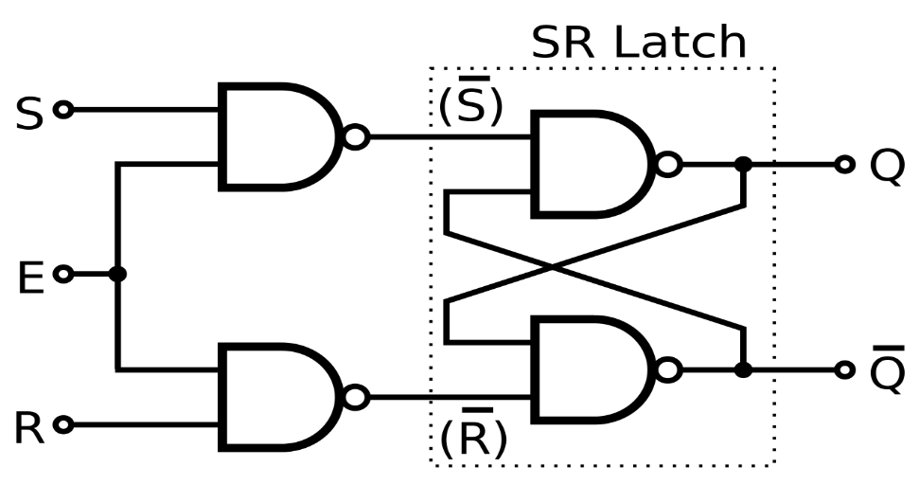
JK Flip Flop
The Racing Problem
Three Possible Solutions:
T/2 < gate delay
Edge Trigger
Master Slave
C

Slide 29
JK Flip Flop
The Racing Problem
Three Possible Solutions:
T/2 < gate delay
Edge Trigger
Master Slave
C
C

Slide 30

JK Flip Flop
The Racing Problem
Three Possible Solutions:
T/2 < gate delay
Edge Trigger
Master Slave
C
C

Slide 31
JK Flip Flop
The Racing Problem
Three Possible Solutions:
T/2 < gate delay
Edge Trigger
Master Slave
C
C

Slide 32
JK Flip Flop
The Racing Problem
Three Possible Solutions:
T/2 < gate delay
Edge Trigger
Master Slave
C
C

Slide 33
JK Flip Flop
The Racing Problem
Three Possible Solutions:
T/2 < gate delay
Edge Trigger
Master Slave
C
C

Slide 34
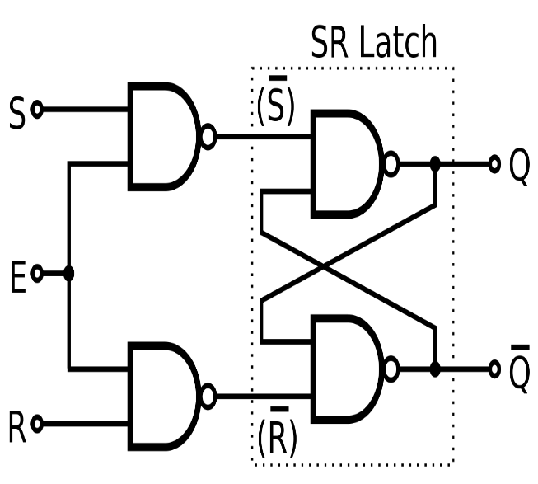
JK Flip Flop
Master Slave JK Flip Flop
C
C

Slide 35
JK Flip Flop
Master Slave JK Flip Flop
Q_{m}
Q_{s}
C
C

Slide 36
JK Flip Flop
Master Slave JK Flip Flop
Note:
When the master is enabled,
The slave is disabled and vice versa
Q_{m}
Q_{s}
C
C

Slide 37
JK Flip Flop
Master Slave JK Flip Flop
Note:
When the master is enabled,
The slave is disabled and vice versa
Q_{m}
Q_{s}
C
C
Assume J=1,K=1
Clock
Qm
Qs

Slide 38
JK Flip Flop
Master Slave JK Flip Flop
Note:
When the master is enabled,
The slave is disabled and vice versa
1
0
0
0
C
C
1
1
Assume J=1,K=1
1
Clock
1
Qm
Qs

Slide 39
JK Flip Flop
Master Slave JK Flip Flop
Note:
When the master is enabled,
The slave is disabled and vice versa
1
0
0
1
0
1
C
C
1
0
1
1
Assume J=1,K=1
1
Clock
0
Qm
Qs

Slide 40
JK Flip Flop
Master Slave JK Flip Flop
Note:
When the master is enabled,
The slave is disabled and vice versa
1
0
1
1
C
C
0
1
Assume J=1,K=1
1
Clock
0
Qm
Qs

Slide 41
JK Flip Flop
Master Slave JK Flip Flop
Note:
When the master is enabled,
The slave is disabled and vice versa
1
0
1
1
0
C
C
0
1
0
Assume J=1,K=1
1
Clock
1
Qm
Qs

Slide 42
JK Flip Flop
Master Slave JK Flip Flop
Note:
When the master is enabled,
The slave is disabled and vice versa
1
1
1
0
C
C
0
0
Assume J=1,K=1
1
Clock
1
Qm
Qs

Slide 43
JK Flip Flop
Master Slave JK Flip Flop
Note:
When the master is enabled,
The slave is disabled and vice versa
1
1
1
0
1
1
C
C
0
0
0
1
Assume J=1,K=1
1
Clock
0
Qm
Qs

Slide 44
JK Flip Flop
Master Slave JK Flip Flop
Note:
When the master is enabled,
The slave is disabled and vice versa
1
1
0
1
1
C
C
1
0
Assume J=1,K=1
0
1
Clock
0
Qm
Qs

Slide 45
JK Flip Flop
Master Slave JK Flip Flop
Note:
When the master is enabled,
The slave is disabled and vice versa
1
1
0
1
0
0
C
C
1
0
1
0
Assume J=1,K=1
1
Clock
1
Qm
Qs

Slide 46
JK Flip Flop
Clock
Clock
J=1
Qm
K=1
Qs
Q

Slide 47
Thank You

